Slide 1
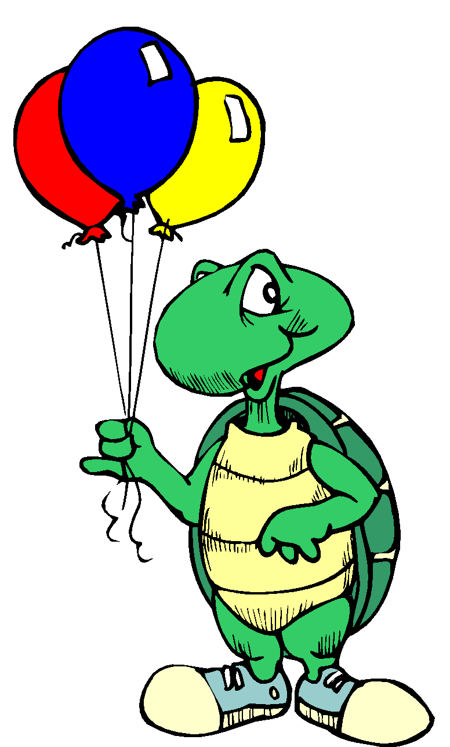

Tucker Turtle Takes Time to Tuck and Think
A scripted story to assist with teaching the “Turtle Technique”
By Rochelle Lentini, University of South Florida
Updated 2007
Created using pictures from Microsoft Clipart® and Webster-Stratton, C. (1991). The teachers and children videotape series: Dina dinosaur school. Seattle, WA: The Incredible Years.

Slide 2
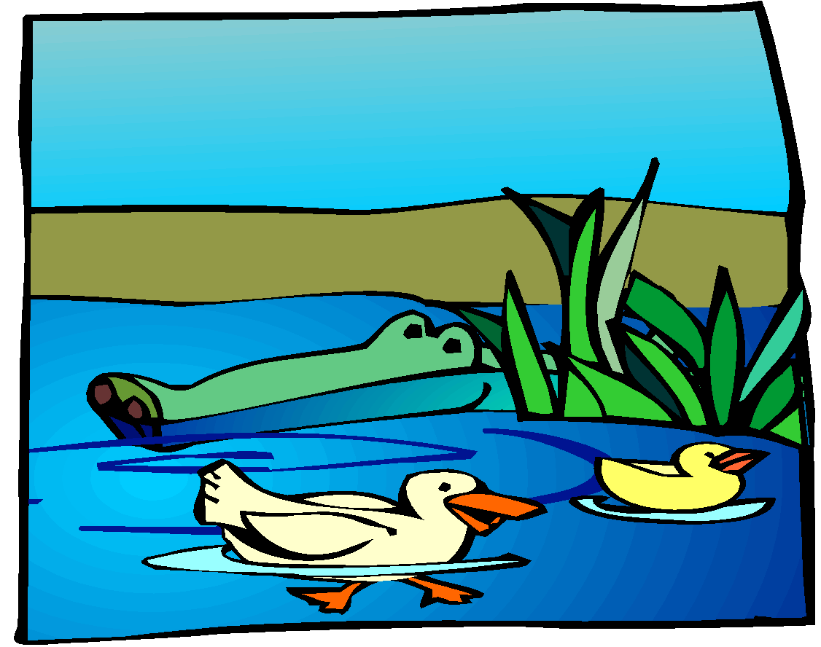
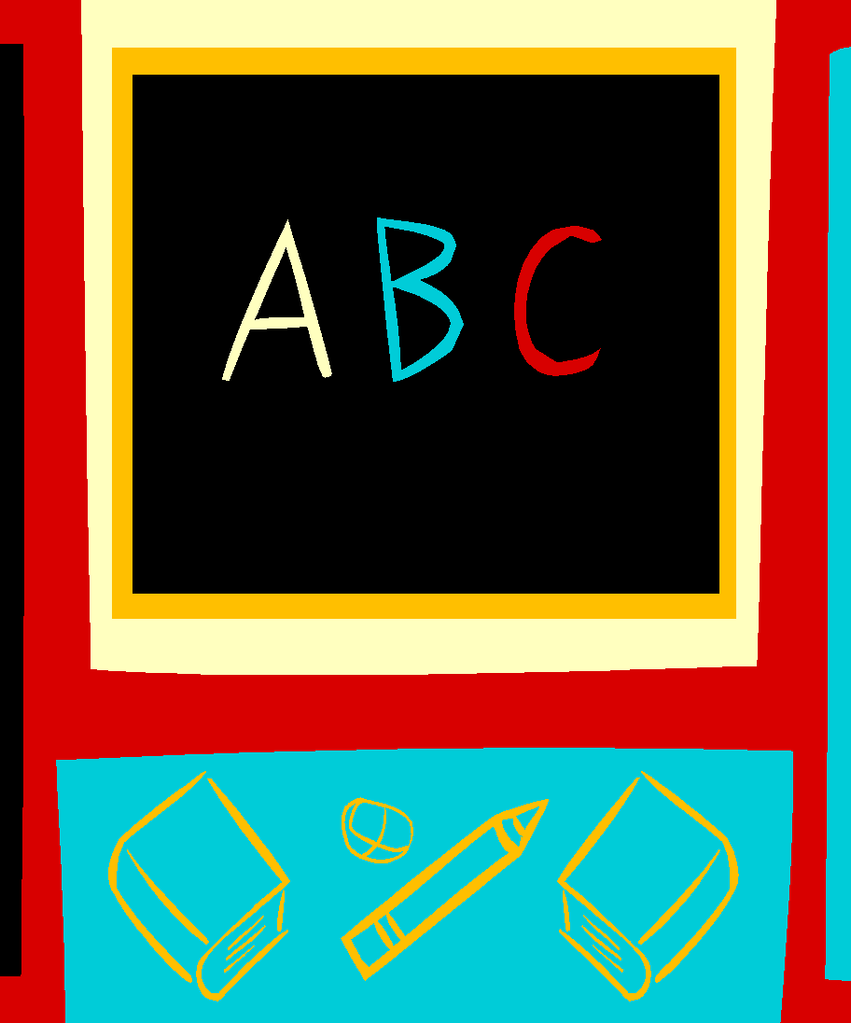
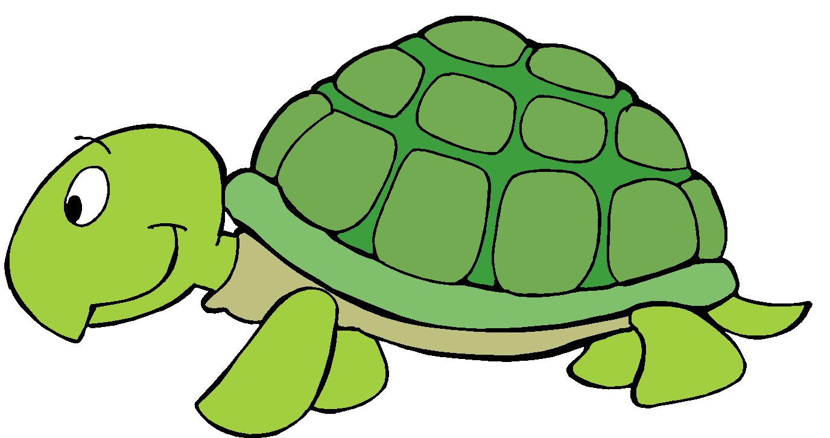
Tucker Turtle is a terrific turtle. He likes to play with his friends at Wet Lake School.

Slide 3

But sometimes things happen that can make Tucker really mad.

Slide 4
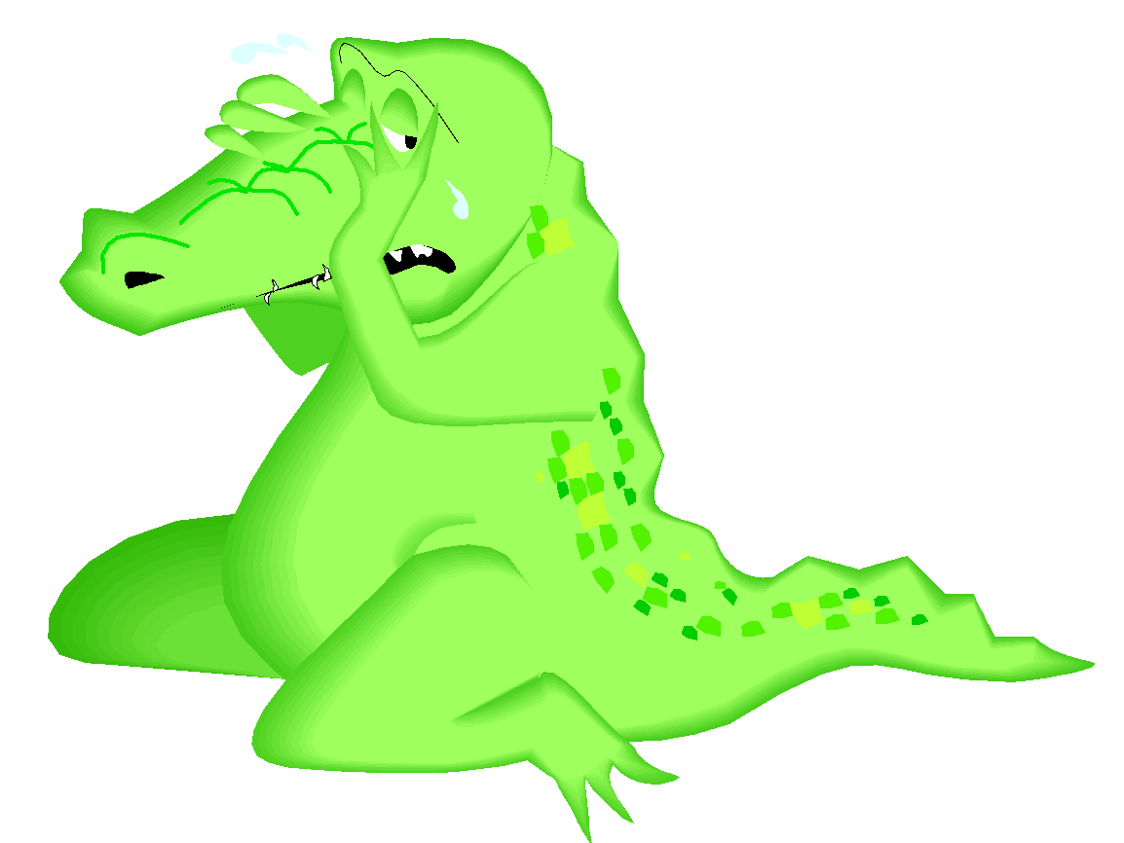
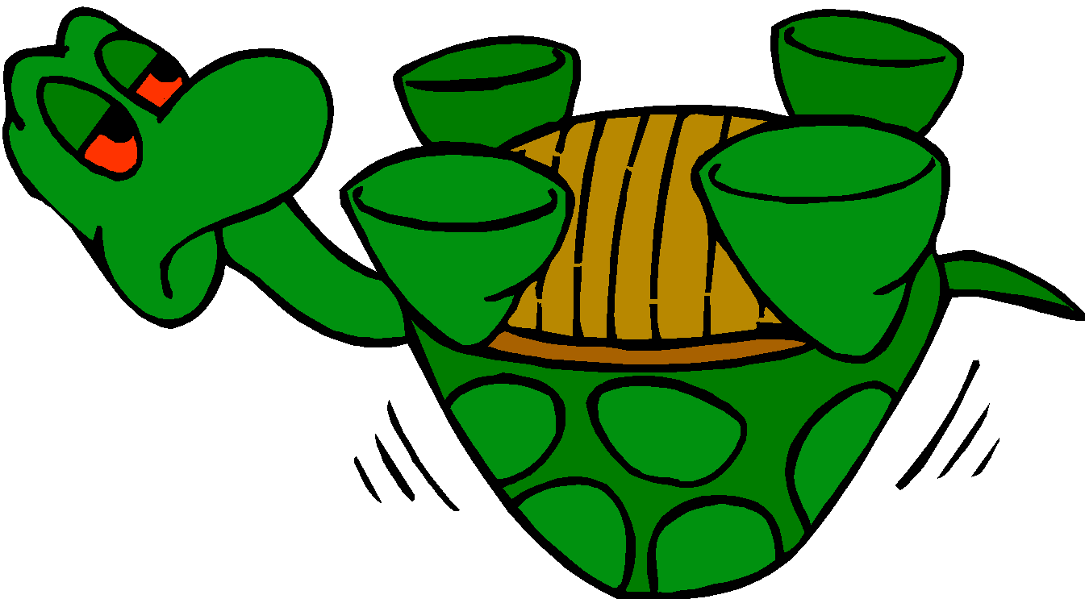


When Tucker got mad, he used to hit, kick, or yell at his friends. His friends would get mad or upset when he hit, kicked, or yelled at them.
Notes:
‹#›

Slide 5
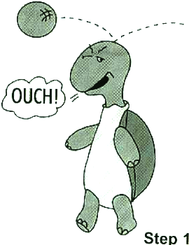
Tucker now knows a new way to “think like a turtle” when he gets mad.
Step 1
Notes:
‹#›

Slide 6
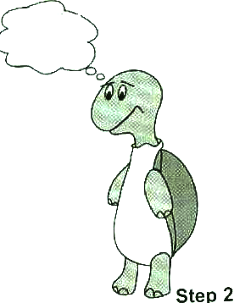
He can stop and keep his hands, body, and yelling to himself!
STOP
Step 2
Notes:
‹#›

Slide 7
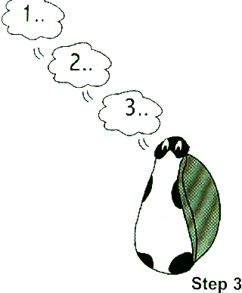
He can tuck inside his shell and take 3 deep breaths to calm down.
Step 3
Notes:
‹#›

Slide 8
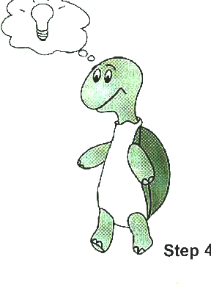
Tucker can then think of a solution or a way to make it better.
Step 4
Notes:
‹#›

Slide 9



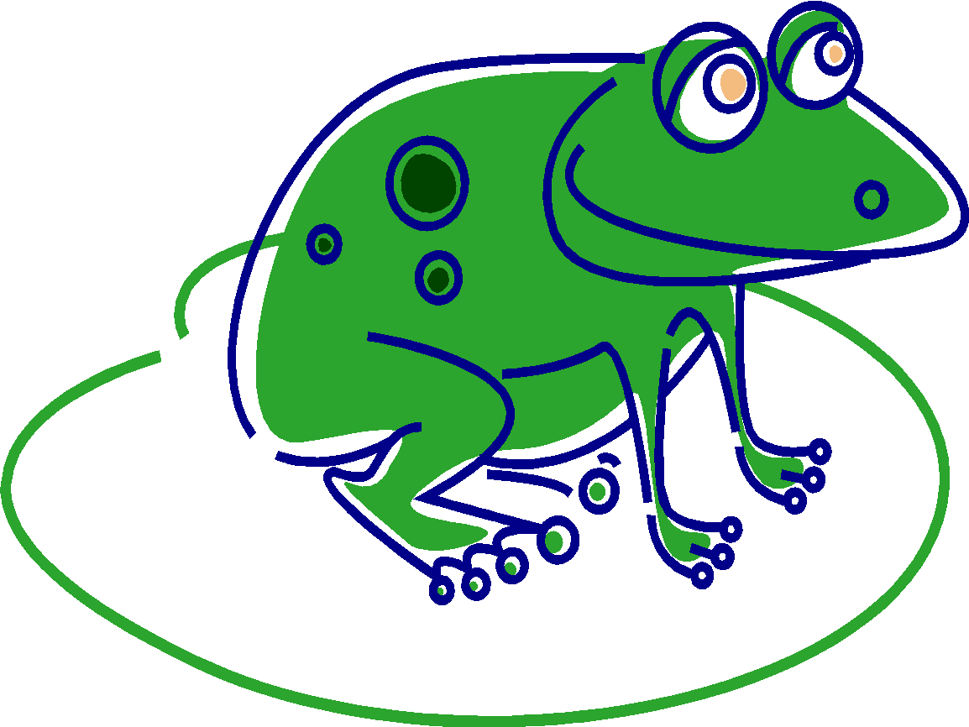
Tucker’s friends are happy when he plays nicely and keeps his body to himself. Friends also like it when Tucker uses nice words or has a teacher help him when he is upset.
Notes:
‹#›

Slide 10
The End!
Notes:
‹#›

Slide 11
Teacher Tips on the Turtle Technique
Model remaining calm
Teach the child the steps of how to control feelings and calm down (“think like a turtle”)
  Step 1: Recognize your feeling(s)
  Step 2: Think “stop”
  Step 3: Tuck inside your “shell” and take 3 deep breaths
  Step 4: Come out when calm and think of a “solution”
Practice steps frequently (see cue cards on next 4 pages)
Prepare for and help the child handle possible disappointment or change and “to think of a solution” (see list on last page)
Recognize and comment when the child stays calm
Involve families: teach the “Turtle Technique”
Webster-Stratton, C. (1991). The teachers and children videotape series: Dina dinosaur school. Seattle, WA: The Incredible Years.
Notes:
‹#›

Slide 12
Step 1
Notes:
‹#›

Slide 13
STOP
Step 2
Notes:
‹#›

Slide 14
Step 3
Notes:
‹#›

Slide 15
Step 4
Notes:
‹#›

Slide 16

Help the Child Think of a Possible Solution:
Get a teacher
Ask nicely
Ignore
Play
Say, “Please stop.”
Say, “Please.”
Share
Trade a toy/item
Wait and take turns
Etc.
Notes:
‹#›

Slide 17
Scripted Story Tip
Please note that you can use real photographs with the line drawings for children that need this level of support. For instance, next to the line drawings, you can glue or Velcro a photograph of the class using the ‘turtle technique’. Snap a photo of the children showing how they stop, think, and take three deep breaths.
Notes:
‹#›

